Slide 1

Session 3.2
Information Gathering-Part 2
Web Application Penetration Testing (WAPT)
Diploma in CSF
Year 2 (2021/22), Semester 2.2

Slide 2
Learning Outcomes
At the end of this session, the learners are expected to be able
Distinguish between passive and active reconnaissance
Profile web application system architecture
Detect the system OS and services running in the hosting device
Map out the directories and files in the hosting device
Map out the web application using web spidering tool
Find hidden contents
Create Flow Chart for the web application
Carry out Contents Relationship Analysis

Slide 3
Contents
Passive vs Active Reconnaissance
Profiling Web Application Infrastructure
Discovering the OS & Services running on the Hosting Machine
Finding Directories and Files
Mapping the Web Application/Web Spidering
Finding Hidden Contents
Flow Charting
Contents Relationship Analysis

Slide 4
Passive vs Active Reconnaissance

Slide 5
Passive vs. Active Recon
Passive Reconnaissance
Based on the concept that information obtained from Public Domain or published information
Information Gathering Activities in Session 3.1
Active Reconnaissance
Any other information that pen-tester needs to carry out testing the web-site or web application system.
Information Gathering Activities in this Session 3.2
09/11/2021
11/9/2021

Slide 6
Active Reconnaissance

Slide 7
Active Reconnaissance – In Reality
Active reconnaissance would mean to probe the actual server to gather detailed system information.
“system” refers to every single components that are needed to make the web application operational.

Slide 8
Detailed system information include:
Web Site Infrastructure
OS of the Host that is hosting the Server
Active Ports & Services
Software & Version running on the Host
Web Directory/Folders
Web Application Site Map & Logic Flow

Slide 9
Assumptions
For the purpose of this lesson, we assume the following:
Black Box Pen-Testing
Test to see the Site can pass OWASP Top 10 (2017) Test
Pen-testers do not have the knowledge on all web technologies. Who has anyway?

Slide 10
Profiling Web Application Infrastructure

Slide 11
Profiling the Web Site Infrastructure
Process aims to understand the Architecture and Technologies in used
Profiling also known as Footprinting
Recommended Approach and Activities
Use Automated Tool to interrogate the target web server
Manually by inspecting the codes behind the application, conversation between the browser and the target servers
Research and construct the supposed Infrastructure
The activities involved use of tools to access the headers are also referred to as Banner Grabbing.
https://securitytrails.com/blog/banner-grabbing
https://www.hackingarticles.in/multiple-ways-to-banner-grabbing/
09/11/2021
11/9/2021

Slide 12
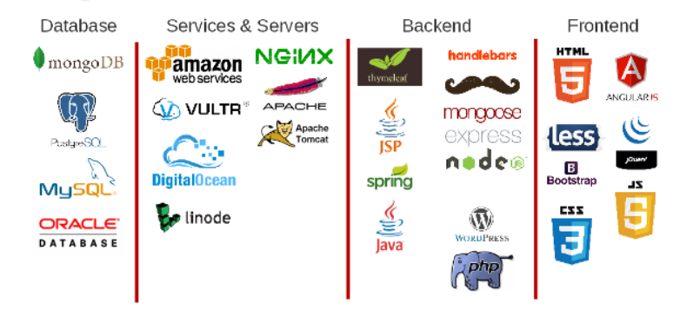
What do they use in the web infrastructure?

Slide 13
Approach to detect Web Site Infrastructure
Use of Automated Tools
whatweb, netcraft, urlscan, “HTTP Header Lives” (Covered in S2.1) & Tools that can be used - from your research activity in S2.2.
Use of Google Search engine
Consolidate and make a best guess.

Slide 14
Discovering OS & Services running on the Hosting Machine

Slide 15
Discovering the OS & Services running on the Hosting Machine
What OS is the machine hosting Web Applications and Services?
Version? It is vulnerable to Service Side Attack?
What are the opened Ports?
Determine what services are running and waiting for connection.
What is the name of each service and version?
This activity is also known as OS Fingerprinting.
https://securitytrails.com/blog/cybersecurity-fingerprinting

Slide 16
Detect OS Version using Nmap (covered in S2.1)
nmap –O <domain name/server IP address>

Slide 17
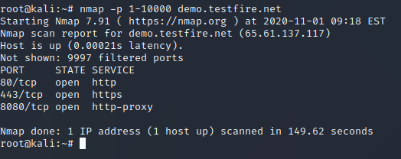
Detect Open Ports using “nmap”
nmap –p 1-n <domain name/server IP address>

Slide 18
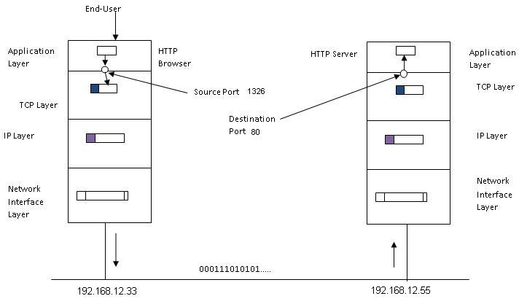
What is a Port?
A port is basically a reference number that make use by the TCP Layer to identify its client (source point) and its service provider(destination port), and vice versa.

Slide 19
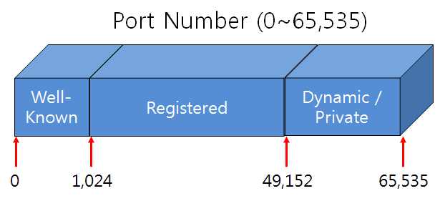
Types of Port

Slide 20
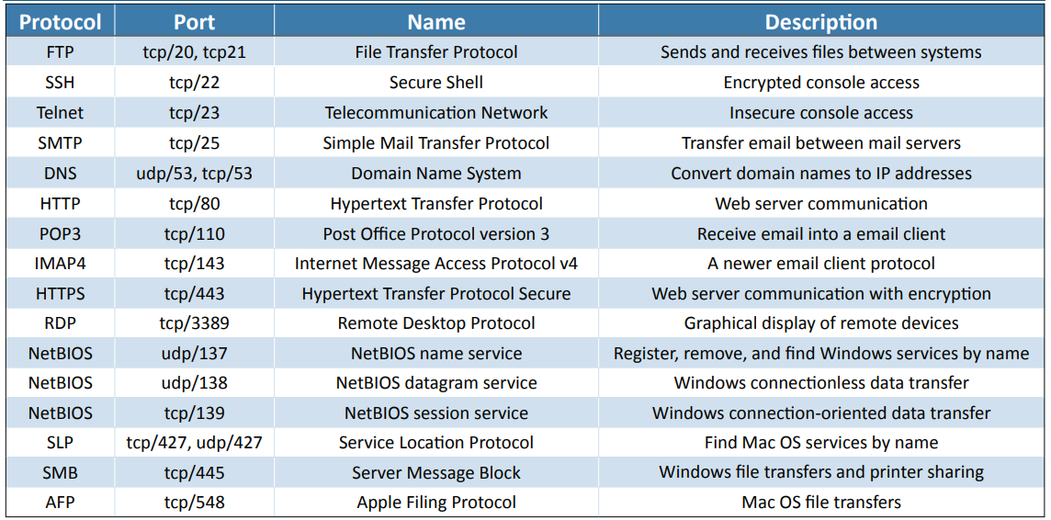
Well Known Port Numbers and Services

Slide 21
Finding Directories and Files

Slide 22
Finding Directories and Files
Web applications are stored in directories or folders that host them.
There are default starting folder in either Linux server or Windows server.
The applications will be stored under these start folders.
Pen-testers need to locate the directories and files related to the web application being pen-tested

Slide 23
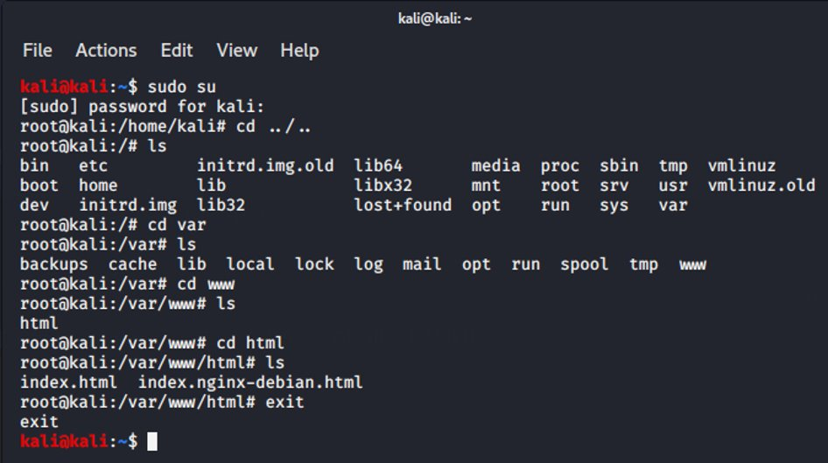
Default Start Folder for Linux Server

Slide 24
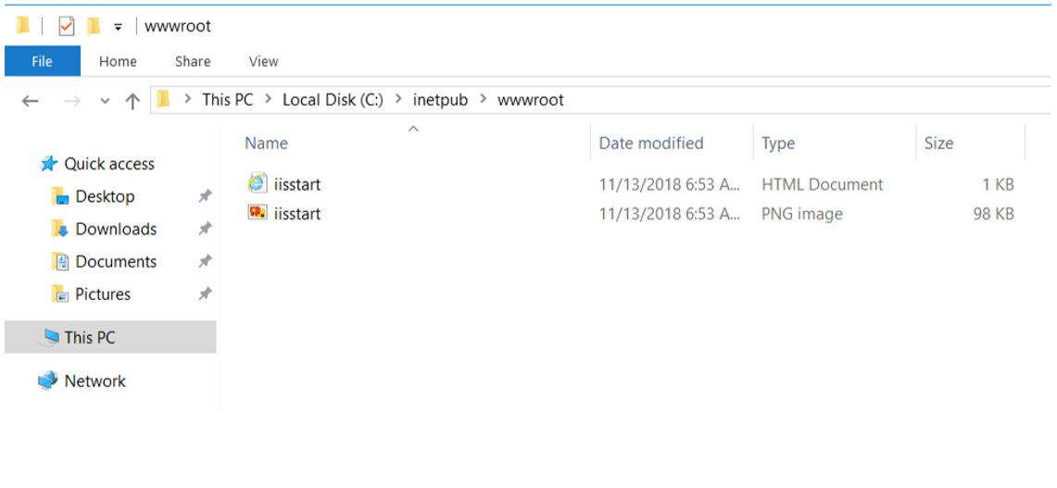
Default Start Folder for Windows Server

Slide 25
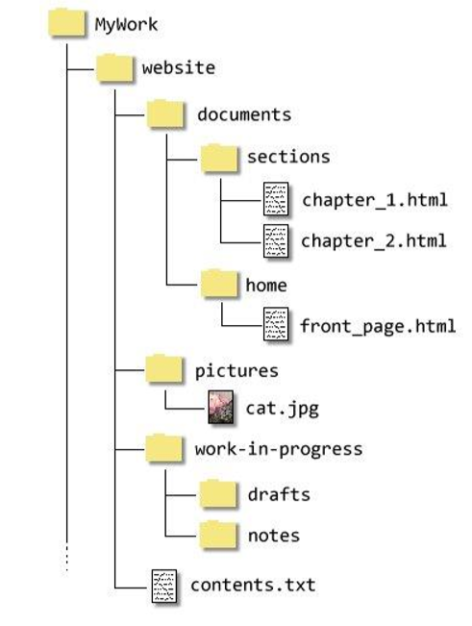
Typical Web Application Directory Structure

Slide 26
Directory brute forcing using "dirb"
Launch a dictionary-based attack against a web server and analyzing the response
Comes with a set of preconfigured attack wordlists for easy usage located at /usr/share/dirb/wordlists/
Can use custom wordlists

Slide 27
"dirbuster" - Directory brute forcing tool
Designed to brute force directories and files names on web/application servers.
Only good as the directory and file list they come with
Comes with a total of 9 different word lists
Generated from scratch, by crawling the Internet and collecting the directory and files that are actually used by developers

Slide 28
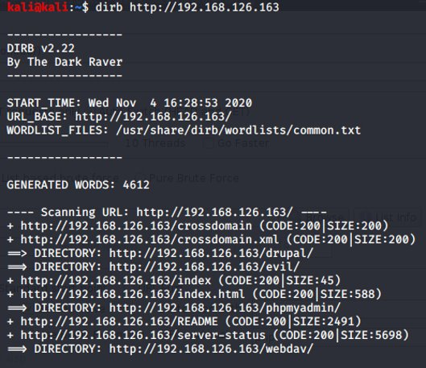
Using "dirb“ command in Kali Linux
dirb <bWAPP server IP address> <wordlist>
Bruit force w default wordlist.

Slide 29
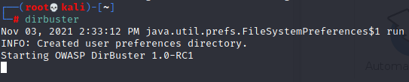
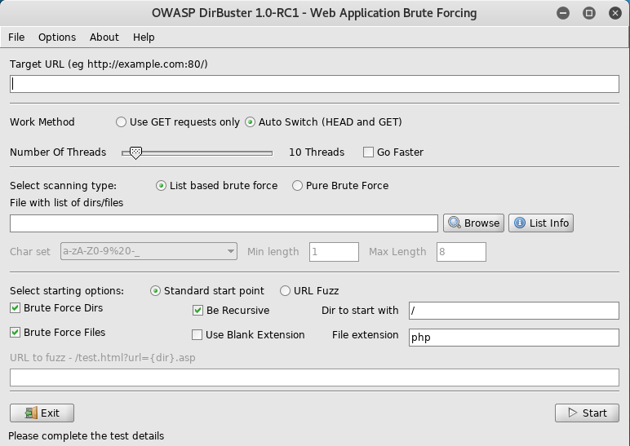
Directory brute forcing using “dirbuster”
#dirbuster

Slide 30
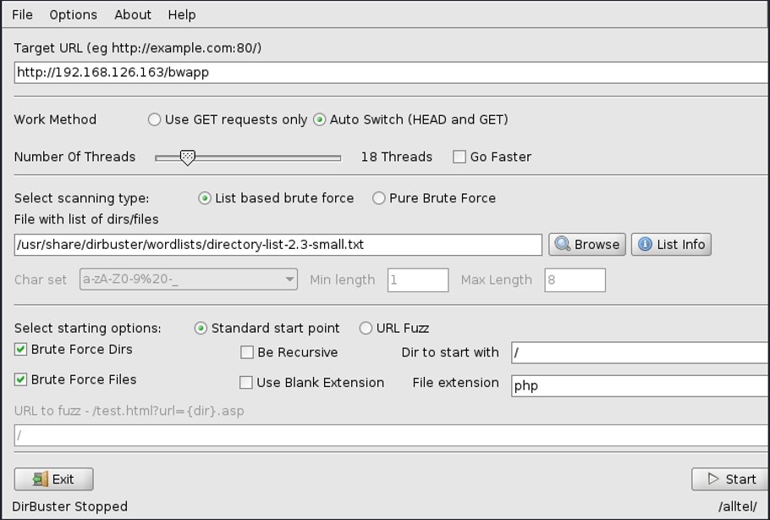

Slide 31
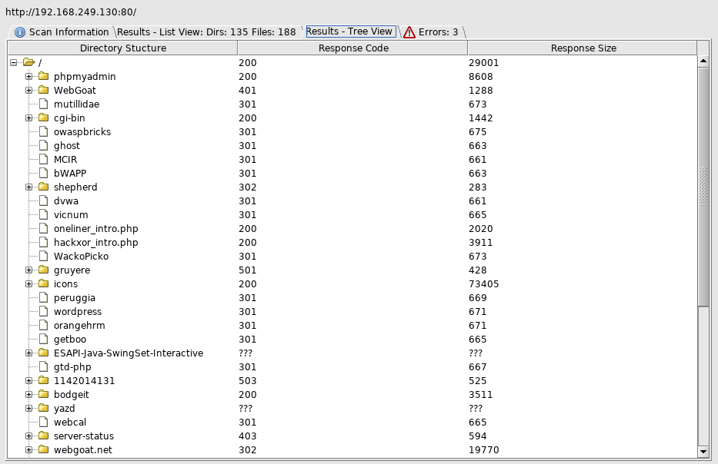

Slide 32
Activity 3.2.1 - Challenge
Pen-testers need to be always on the lookout for tools to help in their pen-testing project.
Research on the Internet to find ONE Directory Brute Forcing tool.
Write a short summary and provide the URL where you found the tool. Post it in the excel spreadsheet in your class team's Week 3 channel.
Complete this before week 4 session.

Slide 33
Spidering the Web Application Site

Slide 34
Concept of Spidering
In web application pen-testing, a crawler or spider is a tool that automatically goes through a website following all links in it and sometimes filling in and sending forms; this allows us to get a complete map of all of the referenced pages within the site and record the requests made to get them and their responses.

Slide 35
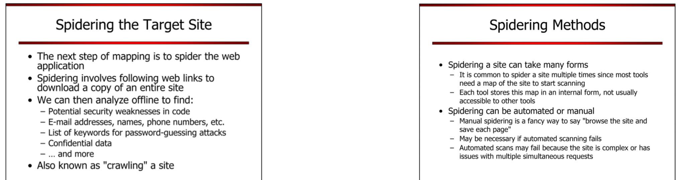

Slide 37
Use of OWASP ZAP tool
OWASP ZAP (short for Zed Attack Proxy) is an open-source web application security scanner. It is intended to be used by both those new to application security as well as professional penetration testers.
It is one of the most active Open Web Application Security Project (OWASP) projects and has been given Flagship status.
When used as a proxy server it allows the user to manipulate all traffics that passes through it, including traffic using https.

Slide 38
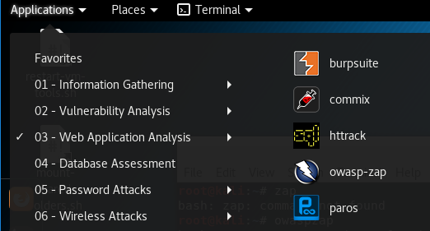
Activity 3.2.2 - Exploration
Spidering using OWASP ZAP
Start “owasp-zap”

Slide 39
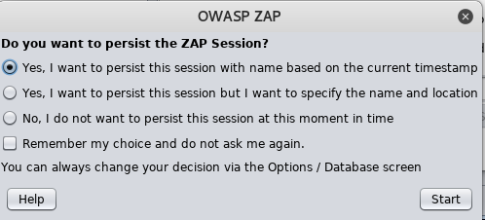
Running for the first time, you may need to answer this question

Slide 40
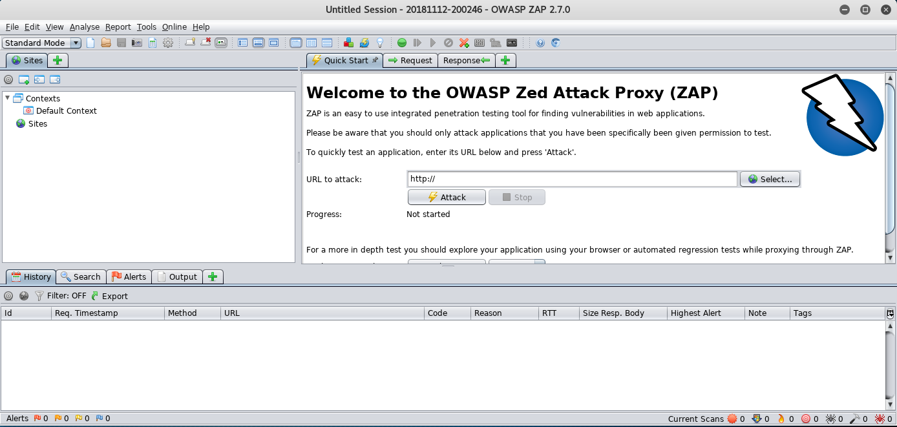

Slide 41
Before you spider a web site ...
Watch this video to learn the different ways you can use ZAP to start spider a web site...
https://www.youtube.com/watch?v=czcy2-7DaII
Use the methods your learned from the video to spider bWAPP/ demo.testfire.net...

Slide 42
Activity 3.2.3 - Exploration
Spider one of the following using “zap”
http://zero.webappsecurity.com
https://juice-shop.herokuapp.com
https://thisislegal.com/
Work in team and document your answers in a PowerPoint file and submit to Week 3 Channel before start of 4.1 lesson in week 4.
Name your file as 1021-A323-Team Name
11/9/2021

Slide 43
Robot.txt

Slide 44
Finding Hidden Contents with “robots.txt”
Web Robots (also known as Web Wanderers, Crawlers, or Spiders), are programs that traverse the Web automatically.
Search engines such as Google use them to index the web content
Web site owners use the /robots.txt file to give instructions about their site to web robots

Slide 45
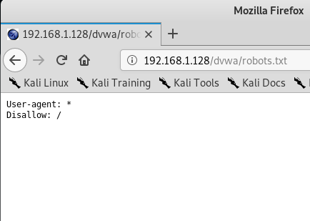
What is robots.txt?
The "User-agent: *" means this section applies to all robots.
The "Disallow: /" tells the robot that it should not visit any pages on the site
Robots can ignore your /robots.txt. Especially malware robots that scan the web for security vulnerabilities
robots.txt file is a publicly available file. Anyone can see what section of your server you don't want robots to use

Slide 46
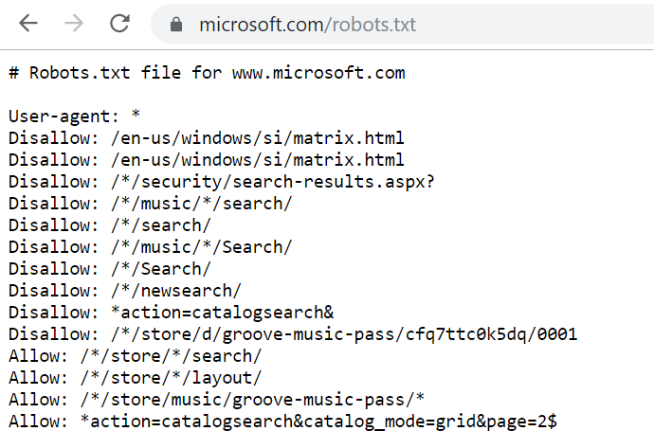

Slide 47
Where is robots.txt?
Your site can have only one robots.txt file.
The robots.txt file must be located at the root of the website host to which it applies.
For instance, to control crawling on all URLs below http://www.example.com/ , the robots.txt file must be located at http://www.example.com/robots.txt .

Slide 48
Flow Charting the Web Application

Slide 49
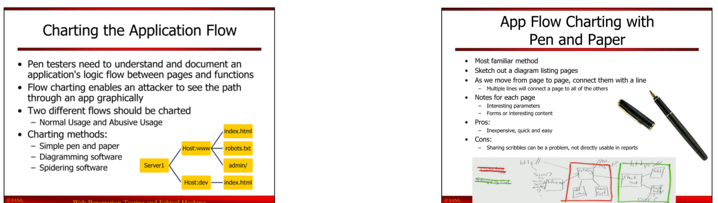
Flow Charting the Web Application

Slide 50
App Flow Charting with Pen and Paper

Slide 51
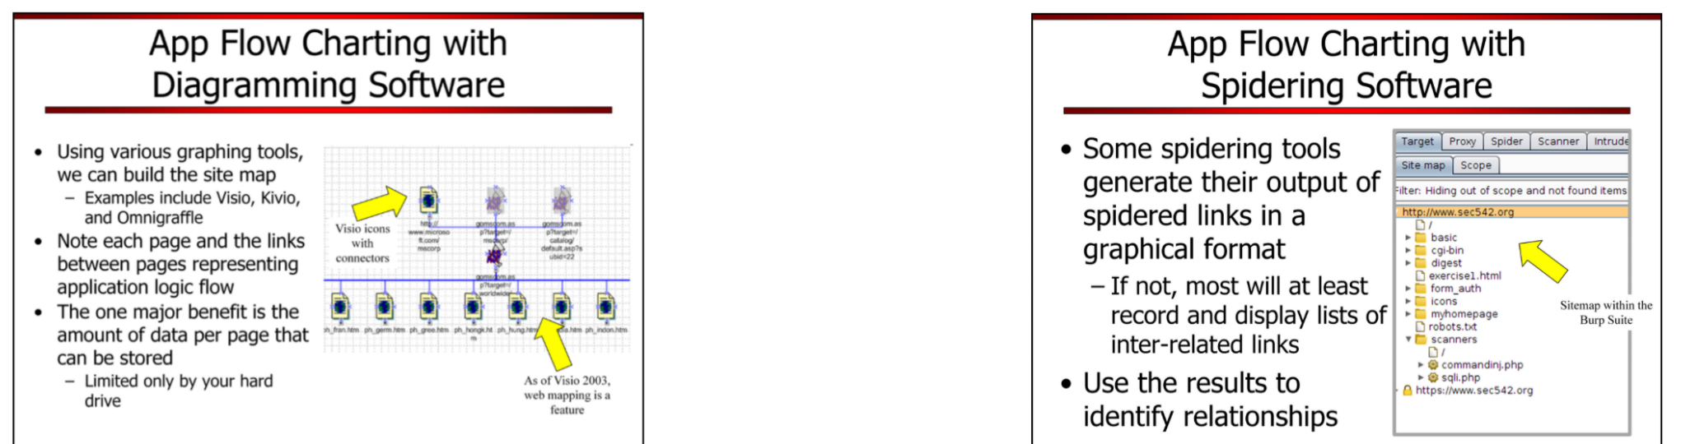
App Flow Charting with Diagramming Software

Slide 52
App Flow Charting with Spidering Software

Slide 53
Contents Relationship Analysis

Slide 54
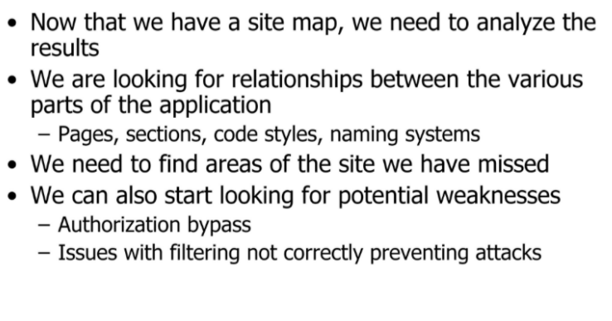
Contents Relationship Analysis

Slide 55
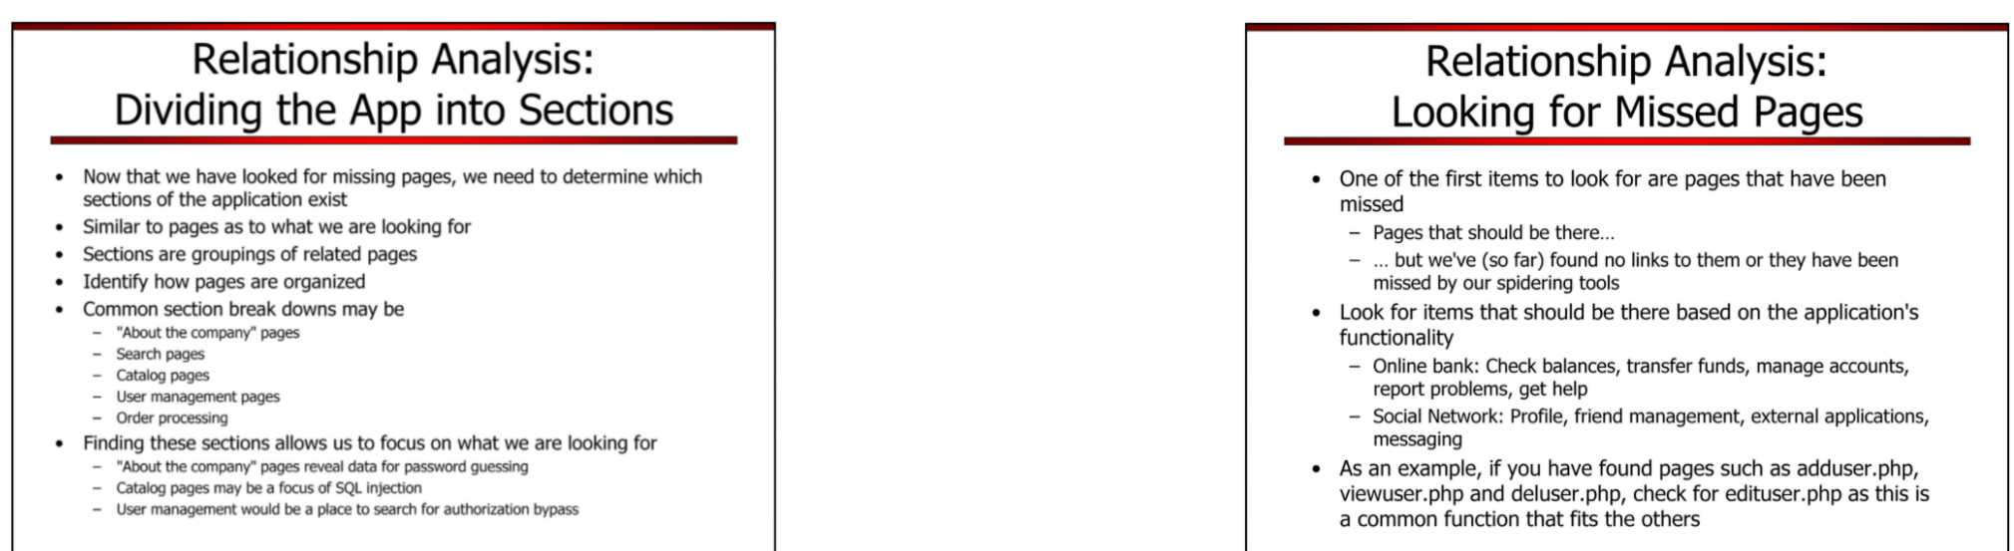
Dividing the App into Sections

Slide 56
Looking for Missed Pages

Slide 57
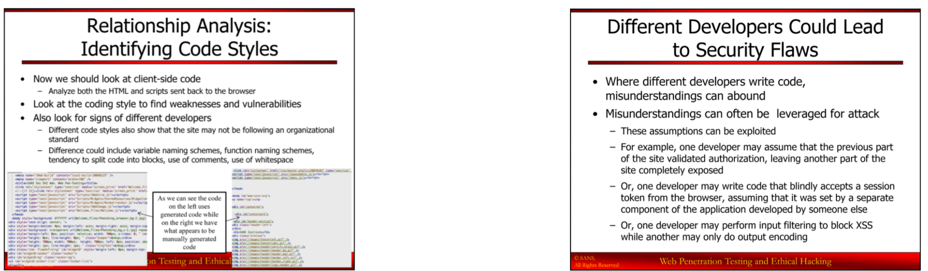
Identifying Code Styles

Slide 58
Different Developers Could Lead to Security Flaws

Slide 59
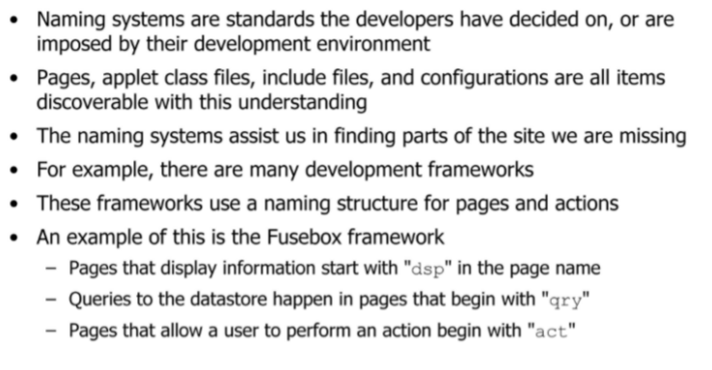
Identifying Naming Systems Used in a Web Application

Slide 60
Summary
We have gone through the followings:
Passive vs Active Reconnaissance
Profiling Web Application Infrastructure
whatweb, netcraft, urlscan.io, HTTP Header Lives, Google Search, nikto
Banner Grabbing
Discovering the OS & Services running on the Hosting Machine
Port Scan, OS Version, Software & Versions
OS Fingerprinting
Finding Directories and Files
dirb, dirbuster
Mapping the Web Application/Web Spidering
zap, burp
Finding Hidden Contents
robots.txt
Flow Charting
Contents Relationship Analysis

Slide 61
End of S3.2

Slide 62
What's coming next ...
Vulnerability Scanning

